Slide 1
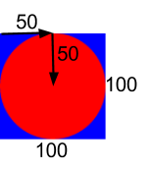
connect each argument to the diagram
include image
#Example
EXAMPLE = I.place-image(
I.circle(50, “solid”, “red”),
50, 50,
I.rectangle(100, 100, “solid”, “blue”))

Slide 2
Reading Pyret documentation
ellipse :: (
width :: Number
height :: Number
mode :: String
color :: Color
)
Constructs an ellipse with the given width, height, mode and color. Corresponds to(ellipse ...) in HtDP.

